Slide 1

Supportive Data Architectures
Breakthrough Listen Workshop @ UC Berkeley. June 2nd, 2016
Rishi Verma
Data Intensive Applications Group
Instrument Software and Science Data Systems
Jet Propulsion Laboratory
Research described in this presentation was carried out at the Jet Propulsion Laboratory, under contract with the National Aeronautics and Space Administration. Copyright 2016 California Institute of Technology. All Rights Reserved. US Government Support Acknowledged.

Slide 2
Topics
Workflow Architectures
How can we weave the aforementioned algorithms into an existing production framework?
Execution
How and where can we execute these algorithms?
Data Archiving & Dissemination
How may we obtain and share results?

Slide 3
Workflow Architectures
Distributed
Algorithm
Invocation
Datastore
JSON/XML
Al 1
Al 2
Al 3
Reducer
Datastore
Container Registry
Prod
Local, with
pluggable
containers
File
File
Al 1
Al 2
Al 3
Reducer

Slide 4
Workflow Architectures
1
Algorithmic characteristics to consider when choosing data architectures:
Tolerance of Technical Debt | Code & Data Dependencies | Cognizance of Downstream Consumers | Modularity & Encapsulation
Feedback Loops | Abstraction Debt | Diversity of Languages & Platforms | Extensibility Requirements

Slide 5
Workflow Architectures
2
Key workflow orchestrator criteria:
Parallelization Support | Algorithm Diversity Support | Conditional Branching | Transparency | Software Overhead | Extensibility
A taste of some example architectures used at JPL:
Apache Object Oriented Data Technology (JPL/open source)
Strong extensibility, open source community support and low
technical debt
Common Workflow Service (JPL)
Abstracted workflow service developed at JPL for diverse algorithms
requiring conditional branching
Run Deck (open source)
High transparency and low software overhead
Apache Spark (open source)
Strong parallelization support, low algorithm diversity

Slide 6
Execution
3
Factors affecting execution timeliness and cost:
Continuous Data vs. Burst Data | Data Movement Time Tolerance | Hardware Availability | Orchestration Control vs. Abstraction
Some examples at JPL:
Virtualized infrastructure
196+ CPU cluster ideal for continuous data
limited orchestration automation
SciSpark Cluster
128 core clustered computing infrastructure for Spark-based computation
low burst capability
Analytics Cloud
deployment abstraction architecture: stateless code to load-balanced
stateless service
high burst capability: Amazon Web Services’ GovCloud backend
high orchestration automation, high data movement costs

Slide 7
Data Archiving & Dissemination
4
Key criteria
Versioning Control | Data Movement Time | Expected Scale | Hardware Speed | Metadata as a First Class Citizen
Some examples at JPL:
Metadata driven data archive
Planetary Data System Imaging archive
Megacities Carbon Data System
DSN Science Automation
Real-time product dissemination
Deep Space Network Complex Event Processing
Streaming Object Oriented Data Technology
Webification standard to expose file-systems over HTTP
w10n data access standard, developed at JPL: http://w10n.org/spec/

Slide 8
Deep space network Complex event processing
Example

Slide 9
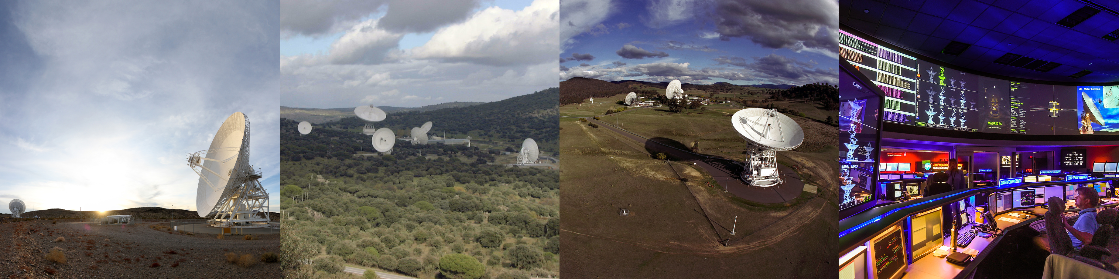
DSN Operations
32 spacecrafts + 17 to be launched over the next 5 years
7 science and ground observation projects
13 deep space antennas + 5 more being built over the next 8 years
Various types of receivers, amplifiers, telemetry and command subsystems
Support activity: Pre-calibration, in-track, and post-track
Simple automation: Temporal Dependency Network
Expert operators staffed 24/7
Goal: Follow-the-Sun Operations
Notes:
Mission set also includes “LEO Emergency Only Support Missions.”

Slide 10
DSN Ops Data Fabric
Data Type | Temporal Nature | Producers | Source for DCEP | Format
Monitor Data (eqpt status, weather, etc.) | Real-time | DSN subsystems (includes NMC) | MDS (Currently: MON-2/JMS bridge) | Proprietary binary data
NMC/TDN Logs | Real-time and historical | NMC subsystem (also TDN) | NMC FileSystem (NMCFS) | Plain text
Other Logs | Real-time and historical | Yet unknown | Yet unknown | Plain text (most likely)
Other Real-Time Indicators | Real-time | Yet unknown | Yet unknown | Yet unknown
Schedule Items | Planned | SPS | SPS REST server | XML
Sequence of Events | Planned and predicted | SPS | SPS REST server | XML
Predicts | Planned | SPS | SPS REST server | XML
Astrophysics Data | Predicted | LTPS | LTPS REST server | Plain text
Service Quality Assessment Data | Historical | DSN subsystems (includes NMC) | SQA server | PL/SQL collections
DRs and MDRs | Historical | Operators | DRMS | Form data in English
Notes:
Monitor data includes: weather, equipment status, signal levels, loop status, etc.
NMC/TDN logs contain operator/TDN directives and responses

Slide 11
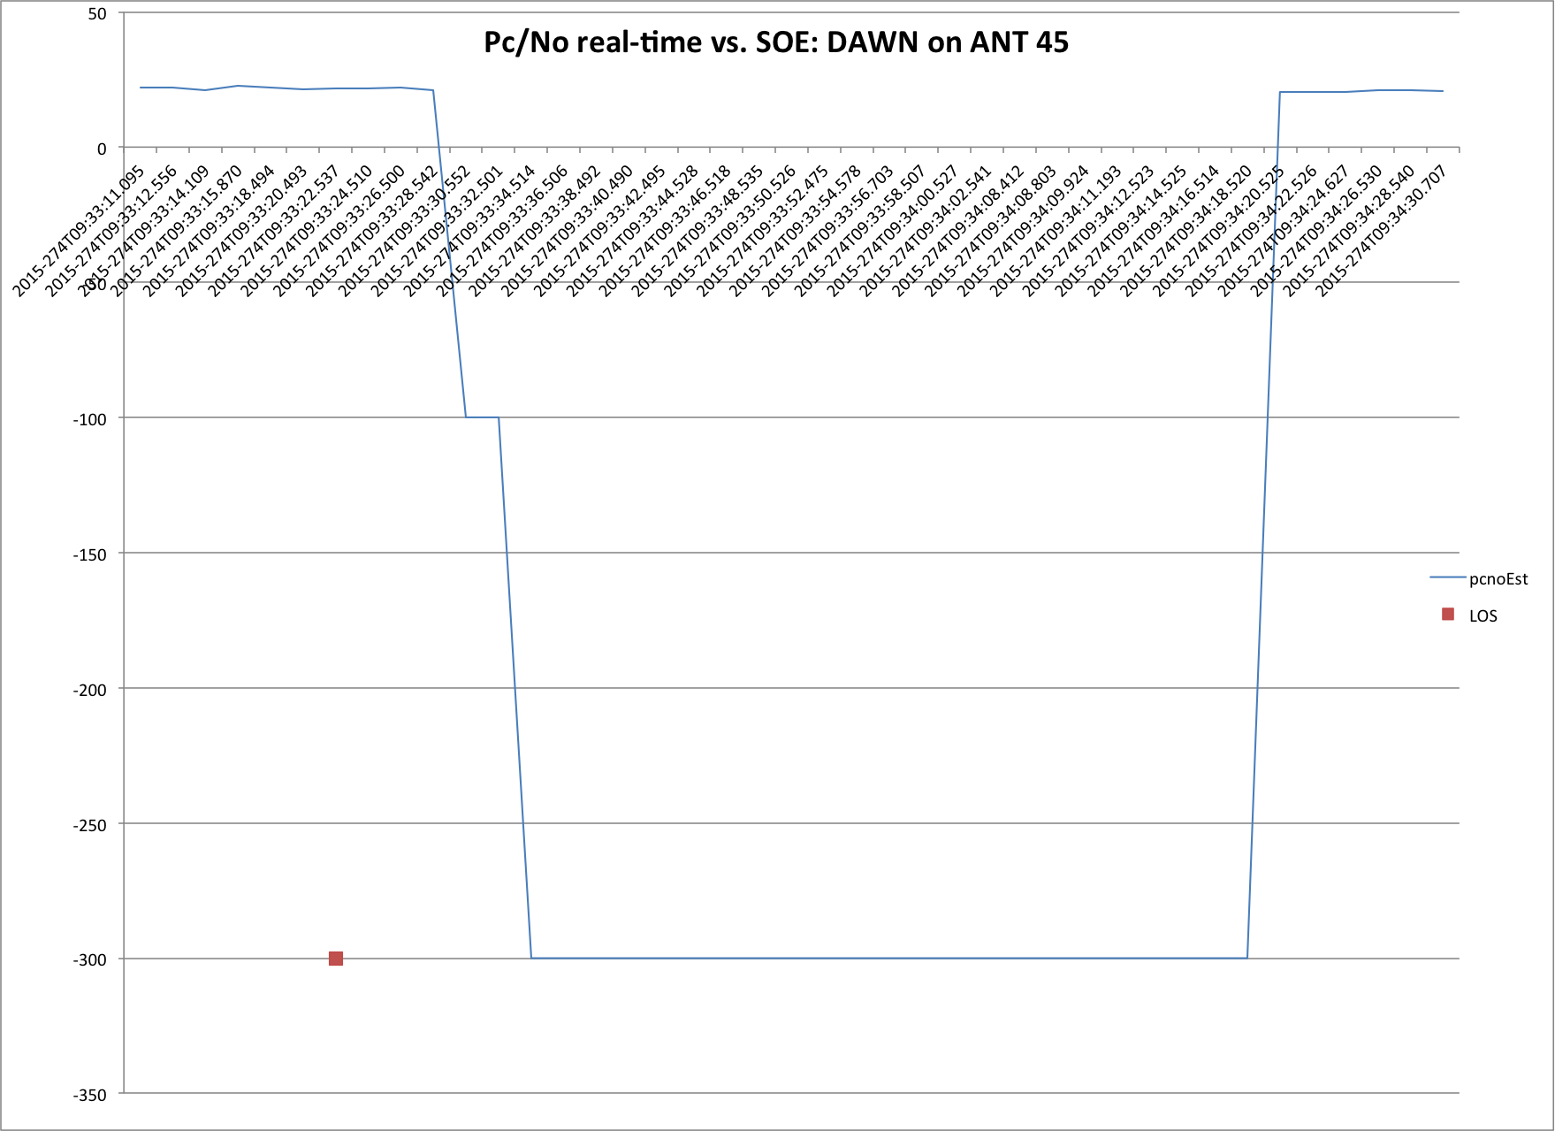
Use case: loss of signal discrepancy, is this nominal?
Predicted LOS vs. actual: 7 seconds

Slide 12
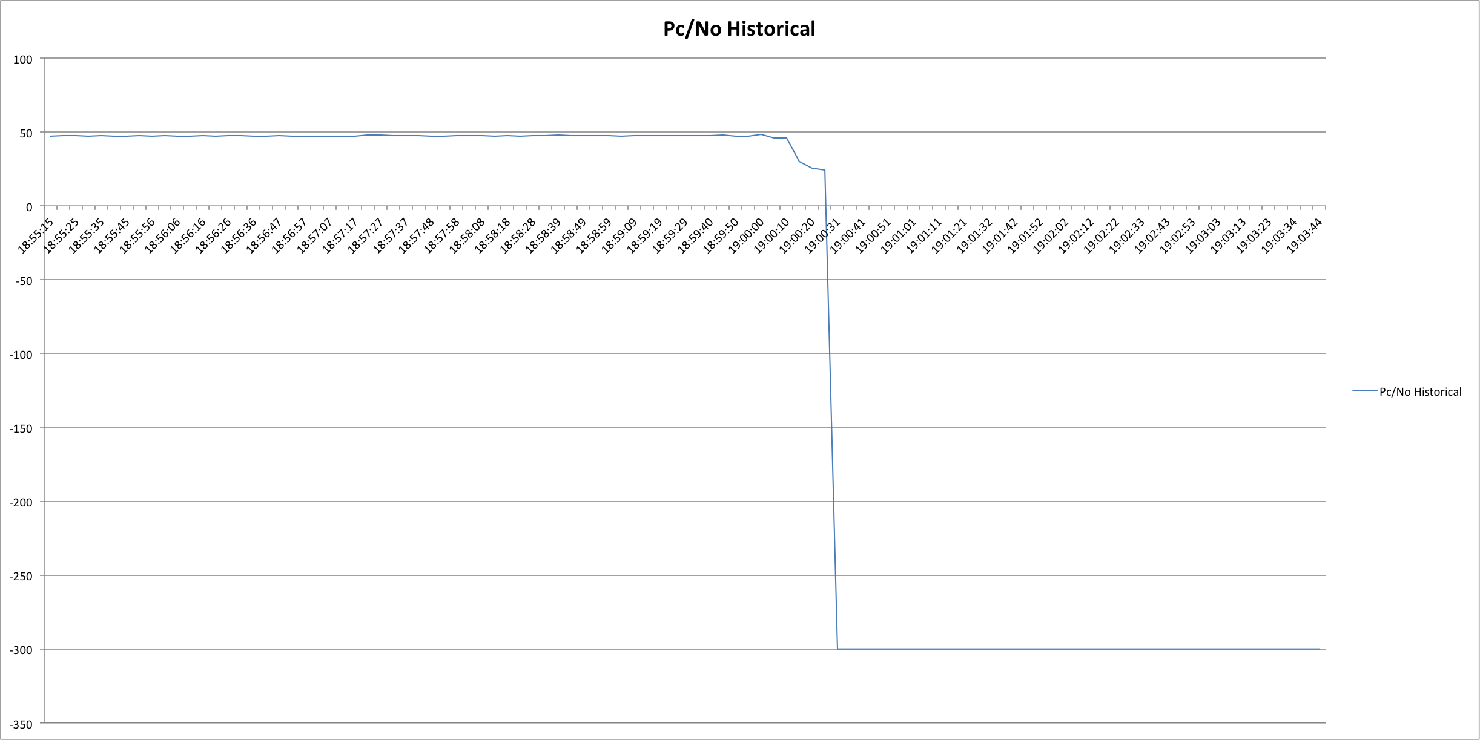
“History is a vast early warning system.”
Average Pc/No over the previous week: 42.015 dB-Hz
Predicted LOS vs. actual: 7 seconds
Historical predicted vs. actual LOS: 1min 38 seconds

Slide 13
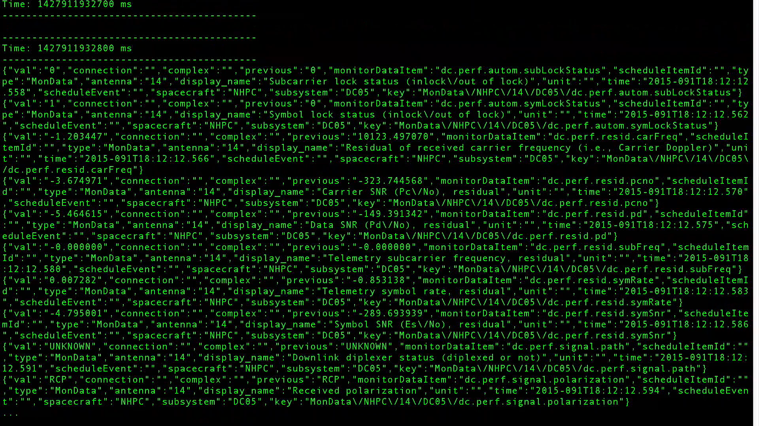

Slide 14
Backup slides

Slide 15
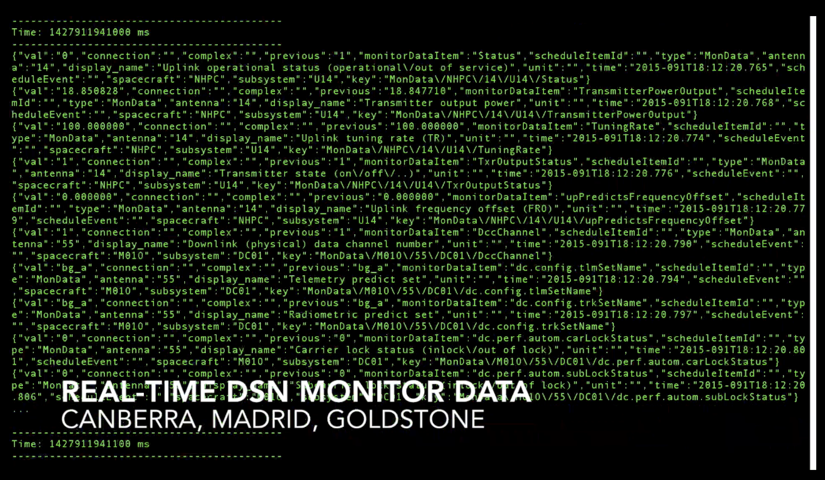

Slide 16
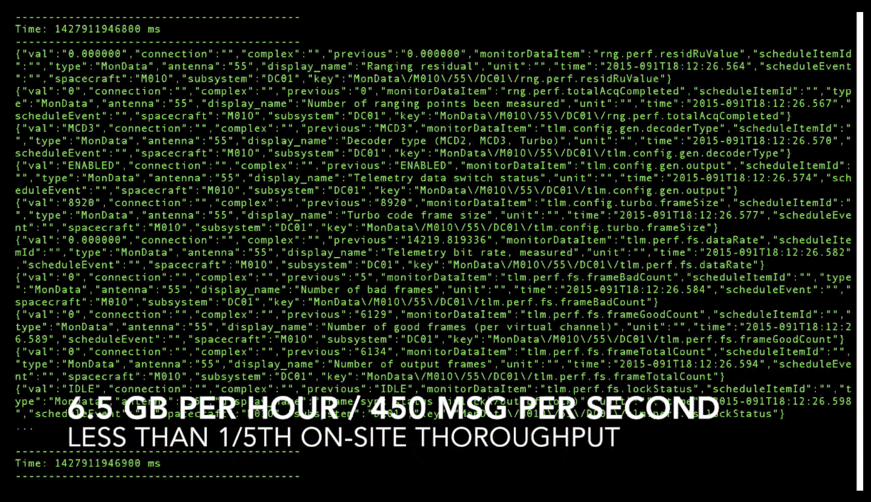

Slide 17
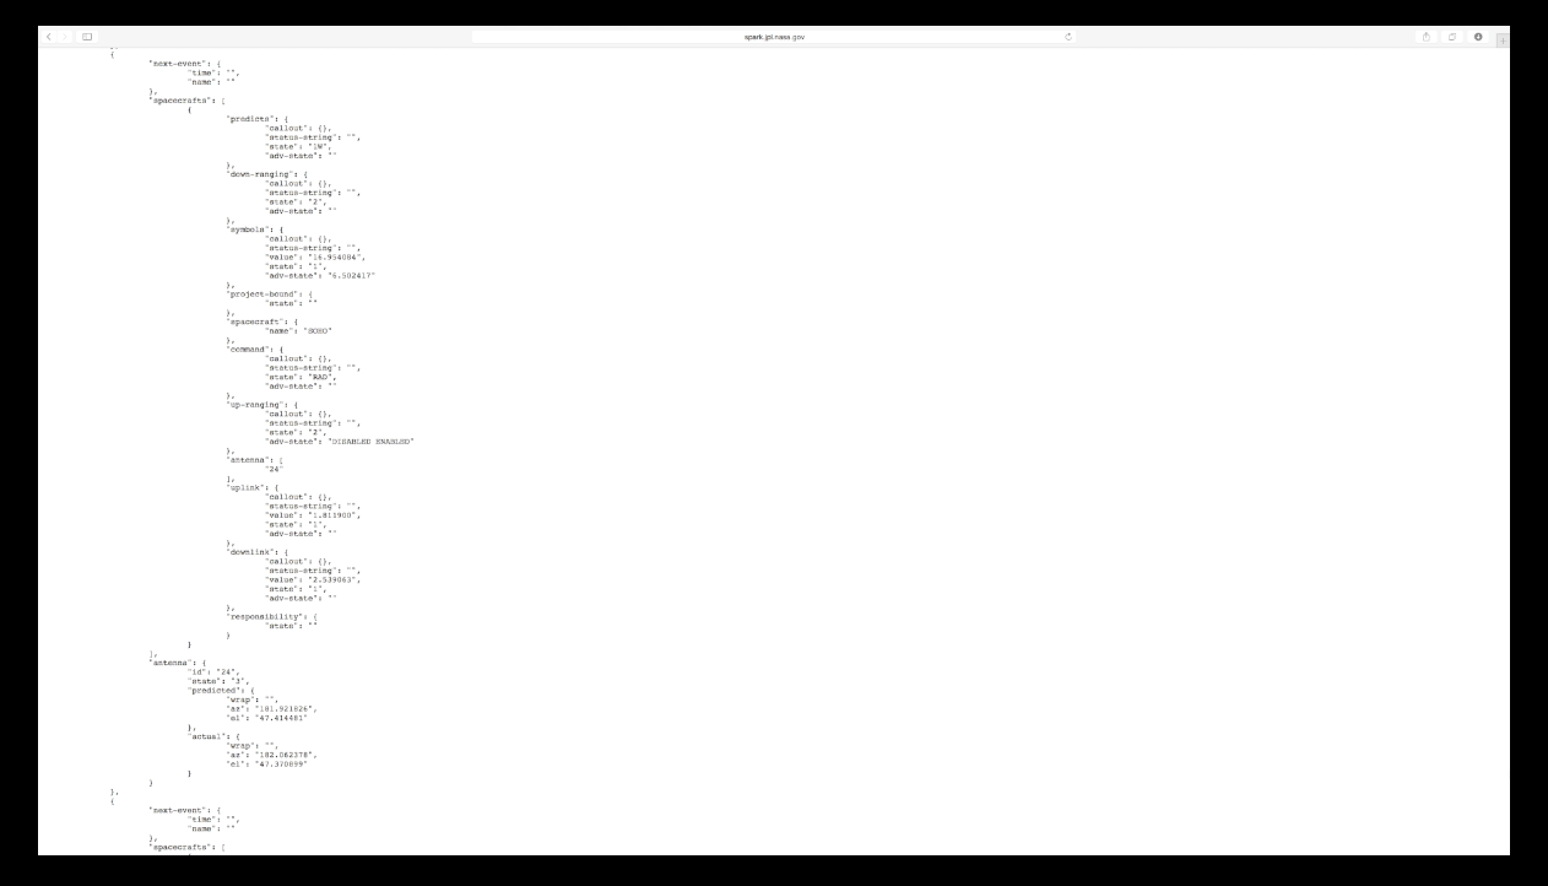

Slide 18
